Slide 1
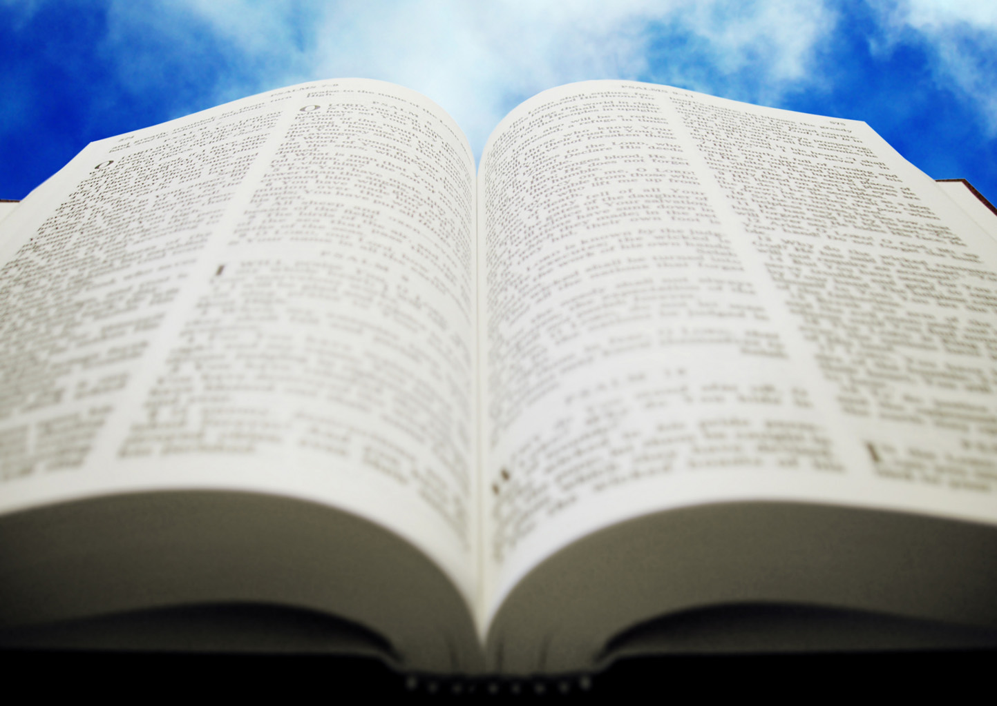
Welcome!
Sunday
Bible Study 9:30 AM
Worship 10:30 AM
PM Bible Class (Livestream) 5:00 PM
Wednesday
Bible Class 7:00 PM
www.SunsetchurchofChrist.net

Slide 2
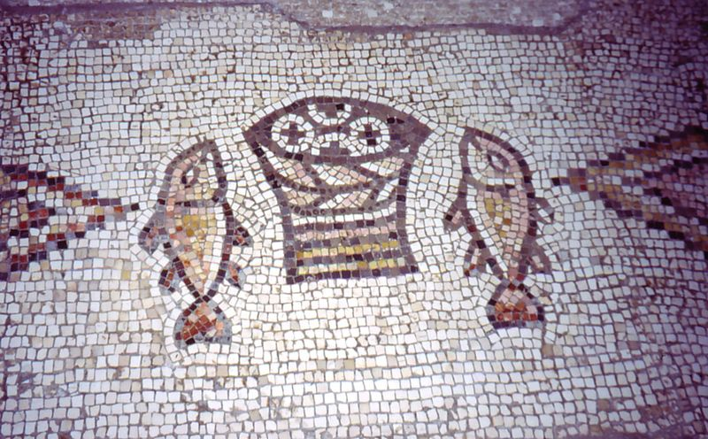
John 6:1-14
Loaves and Fishes
“Truly this is the Prophet”
Notes:
https://commons.wikimedia.org/wiki/File:Tabgha_Church_Mosaic_Israel.jpg

Slide 3
John 6:15-21
Jesus walking on the water
Matthew 14:33:
Peter joins Jesus walking
“Truly you are the Son of God”

Slide 4
John 6:22
Loaves and Fishes
Nearing the Passover
“Truly this is the Prophet”

Slide 5
Welcome!
Sunday
Bible Study 9:30 AM
Worship 10:30 AM
PM Bible Class (Livestream) 5:00 PM
Wednesday
Bible Class 7:00 PM
www.SunsetchurchofChrist.net

Slide 6
Opening Prayer | Rob Wade
Song – 155 | George Watkins
Scripture Reading | Lamar McDonald
Song – 451 | George Watkins
Song – 696 | George Watkins
Lord’s Supper | Lamar McDonald, Luis Gonzalez
Song – 504 | George Watkins
Collection | Lamar McDonald, Brian Haines
Song – 536 | George Watkins
Lesson | Brian Haines
Song – 272 | George Watkins
Closing | Antony Ward

Slide 7
The Treasure of Salvation

Slide 8
The Treasure
"Again, the kingdom of heaven is like treasure hidden in a field, which a man found and hid; and for joy over it he goes and sells all that he has and buys that field.” Matthew 13:44
Notes:
Ga 6:9 And let us not grow weary while doing good, for in due season we shall reap if we do not lose heart.

Slide 9
The Treasure
“Again, the kingdom of heaven is like a merchant seeking beautiful pearls, who, when he had found one pearl of great price, went and sold all that he had and bought it.” Matthew 13:45
Notes:
Ga 6:9 And let us not grow weary while doing good, for in due season we shall reap if we do not lose heart.

Slide 10
The Treasure
Treasure in the field
Stumble across it by accident
Do everything to obtain it
Pearl in the bazaar
Seeking for it earnestly
Do everything to obtain it
Notes:
Ga 6:9 And let us not grow weary while doing good, for in due season we shall reap if we do not lose heart.

Slide 11
The Treasure
Its value is limited while possessing it
Find a time to exchange it
How would you treat it?
Notes:
Imgaine setting up an appointment with an appraiser to come value and perhaps buy your tereasure

Slide 12
The Treasure
Salvation is a Treasure
Found either by accident or search
Requires everything to get it
Its value is found at the end
How should you treat it?
Notes:
Ac

Slide 13
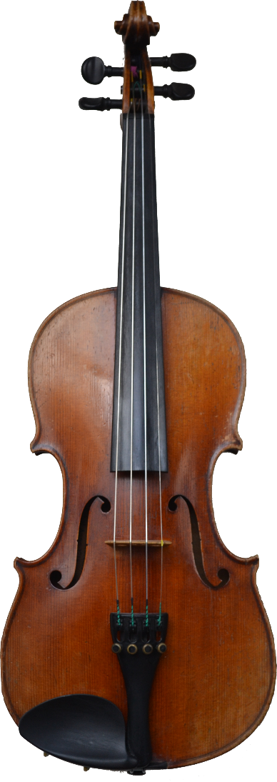
Don’t Neglect It
Hebrews 2:1-4
Salvation must be cared and nurtured
Nourished and fed
Given attention
Being unused leads to decay

Slide 14
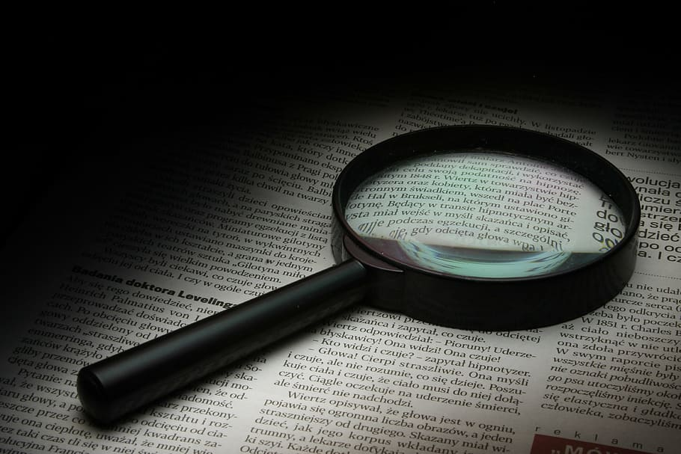
Don’t Miss the Appraiser
Hebrews 4:1-3
Salvation must be saved for a particular day
What if we “miss” the appointment
What if we are not prepared
Missing out = missing everything

Slide 15
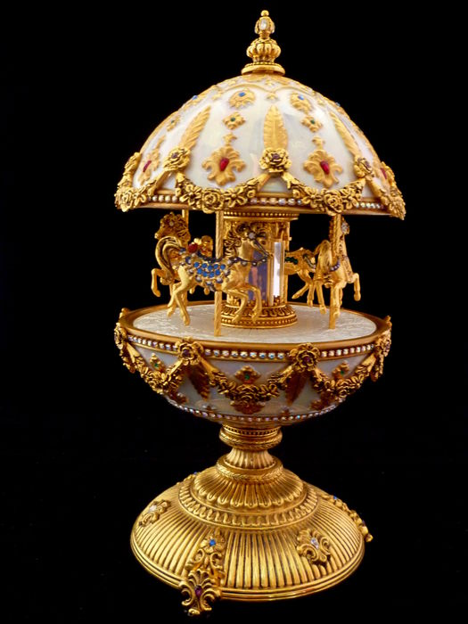
Don’t Drop It
Hebrews 6:4-8
Salvation must be carefully handled
Not exposed to sin
Not discarded
Being dropped leads to damage

Slide 16
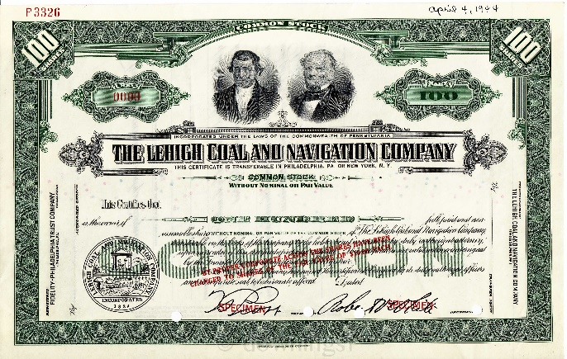
Don’t Void It
Hebrews 10:26-29
Salvation can be invalidated
Not meeting the terms
Treating it disrespectfully
It no longer has any value

Slide 17
Don’t Trade It
Hebrews 12:14-17
Salvation can be given up
Traded for a meal
Lost forever
No hope when the time comes

Slide 18
Losing Your Treasure
Neglect leads to no escape from judgment
Coming short leads to not exchanging it
Carelessness leads to being cursed and burned
Forsaking leads to divine punishment
Trading away leads to great sorrow
Notes:
Ga 6:9 And let us not grow weary while doing good, for in due season we shall reap if we do not lose heart.

Slide 19
Keep Your Treasure
“Treasure” your salvation!
Care for it at any cost
Ensure it remains to the end
Maintain it above all else
Notes:
Ga 6:9 And let us not grow weary while doing good, for in due season we shall reap if we do not lose heart.

Slide 20
Notes:
Lu 18:10 "Two men went up to the temple to pray, one a Pharisee and the other a tax collector. 11 "The Pharisee stood and prayed thus with himself, 'God, I thank You that I am not like other men--extortioners, unjust, adulterers, or even as this tax collector. 12 'I fast twice a week; I give tithes of all that I possess.‘ 13 "And the tax collector, standing afar off, would not so much as raise his eyes to heaven, but beat his breast, saying, 'God, be merciful to me a sinner!‘ 14 "I tell you, this man went down to his house justified rather than the other; for everyone who exalts himself will be humbled, and he who humbles himself will be exalted.“
Mr 11:25 "And whenever you stand praying, if you have anything against anyone, forgive him, that your Father in heaven may also forgive you your trespasses.

Slide 21
Obtaining the Seal
In Him you also trusted, after you heard the word of truth, the gospel of your salvation; in whom also, having believed, you were sealed with the Holy Spirit of promise, Ephesians 1:13
Notes:
Lu 18:10 "Two men went up to the temple to pray, one a Pharisee and the other a tax collector. 11 "The Pharisee stood and prayed thus with himself, 'God, I thank You that I am not like other men--extortioners, unjust, adulterers, or even as this tax collector. 12 'I fast twice a week; I give tithes of all that I possess.‘ 13 "And the tax collector, standing afar off, would not so much as raise his eyes to heaven, but beat his breast, saying, 'God, be merciful to me a sinner!‘ 14 "I tell you, this man went down to his house justified rather than the other; for everyone who exalts himself will be humbled, and he who humbles himself will be exalted.“
Mr 11:25 "And whenever you stand praying, if you have anything against anyone, forgive him, that your Father in heaven may also forgive you your trespasses.

Slide 22
Obtaining the Seal
Then Peter said to them, "Repent, and let every one of you be baptized in the name of Jesus Christ for the remission of sins; and you shall receive the gift of the Holy Spirit.” Acts 2:38
Notes:
Lu 18:10 "Two men went up to the temple to pray, one a Pharisee and the other a tax collector. 11 "The Pharisee stood and prayed thus with himself, 'God, I thank You that I am not like other men--extortioners, unjust, adulterers, or even as this tax collector. 12 'I fast twice a week; I give tithes of all that I possess.‘ 13 "And the tax collector, standing afar off, would not so much as raise his eyes to heaven, but beat his breast, saying, 'God, be merciful to me a sinner!‘ 14 "I tell you, this man went down to his house justified rather than the other; for everyone who exalts himself will be humbled, and he who humbles himself will be exalted.“
Mr 11:25 "And whenever you stand praying, if you have anything against anyone, forgive him, that your Father in heaven may also forgive you your trespasses.

